Slide 1

Influence on observation from
IR / UV divergence during inflation
Yuko Urakawa (Waseda univ.)
Y.U. and Takahiro Tanaka 0902.3209 [hep-th]
Y.U. and Takahiro Tanaka 0904.4415[hep-th]
Alexei Starobinsky and Y.U. in preparation

Slide 2
Contents
Primordial fluctuation generated during inflation
・Influence on observables from IR divergence
- Single field case -
Y.U. and Takahiro Tanaka 0902.3209
・Influence on observables from IR divergence
- Multi field case -
Y.U. and Takahiro Tanaka 0904.4415
・Influence on observables from UV divergence
Alexei Starobinsky and Y.U. 090*.****

Slide 3
► Outline
1. Introduction
2. Cosmological perturbation during inflation
3. IR divergence problem - Single field -
4. IR divergence problem - Multi field -
5. UV divergence problem
6. Summary and Discussions

Slide 4
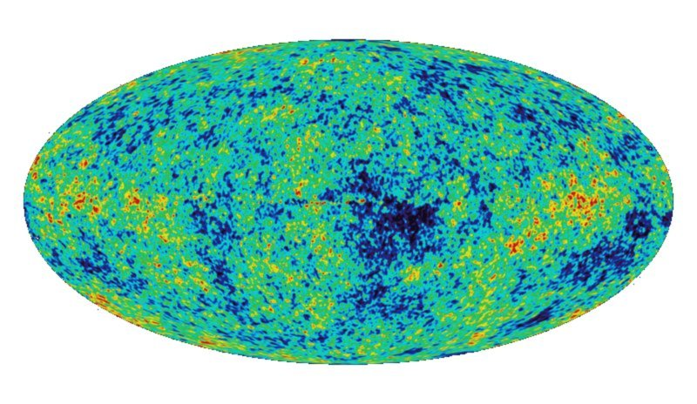
► Cosmic Microwave Background
3
WMAP 1yr/3yr/5yr…
Almost homogeneous and isotropic universe
with small inhomogeneities

Slide 5
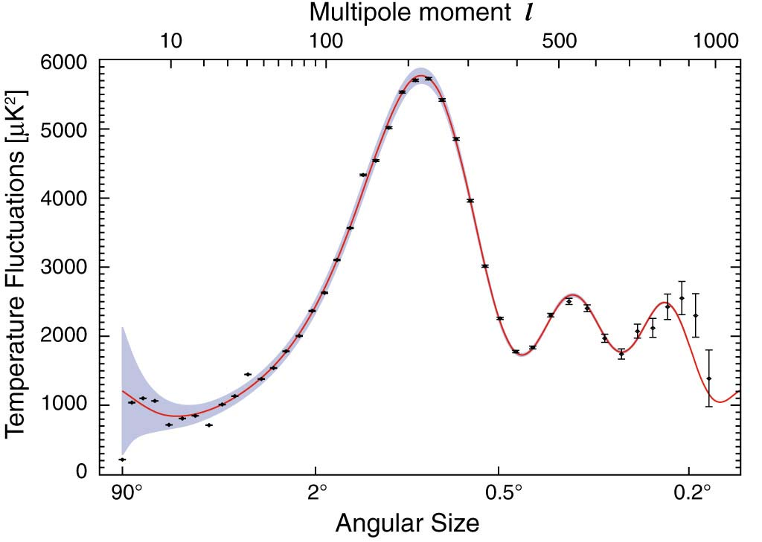
► CMB angular spectrum
4
Harmonic expansion
Ω_{m}
Ω_{b}
Ω_{Λ}
Ω_{K}
P
Primordial spectrum
← Large scale
Small scale →

Slide 6
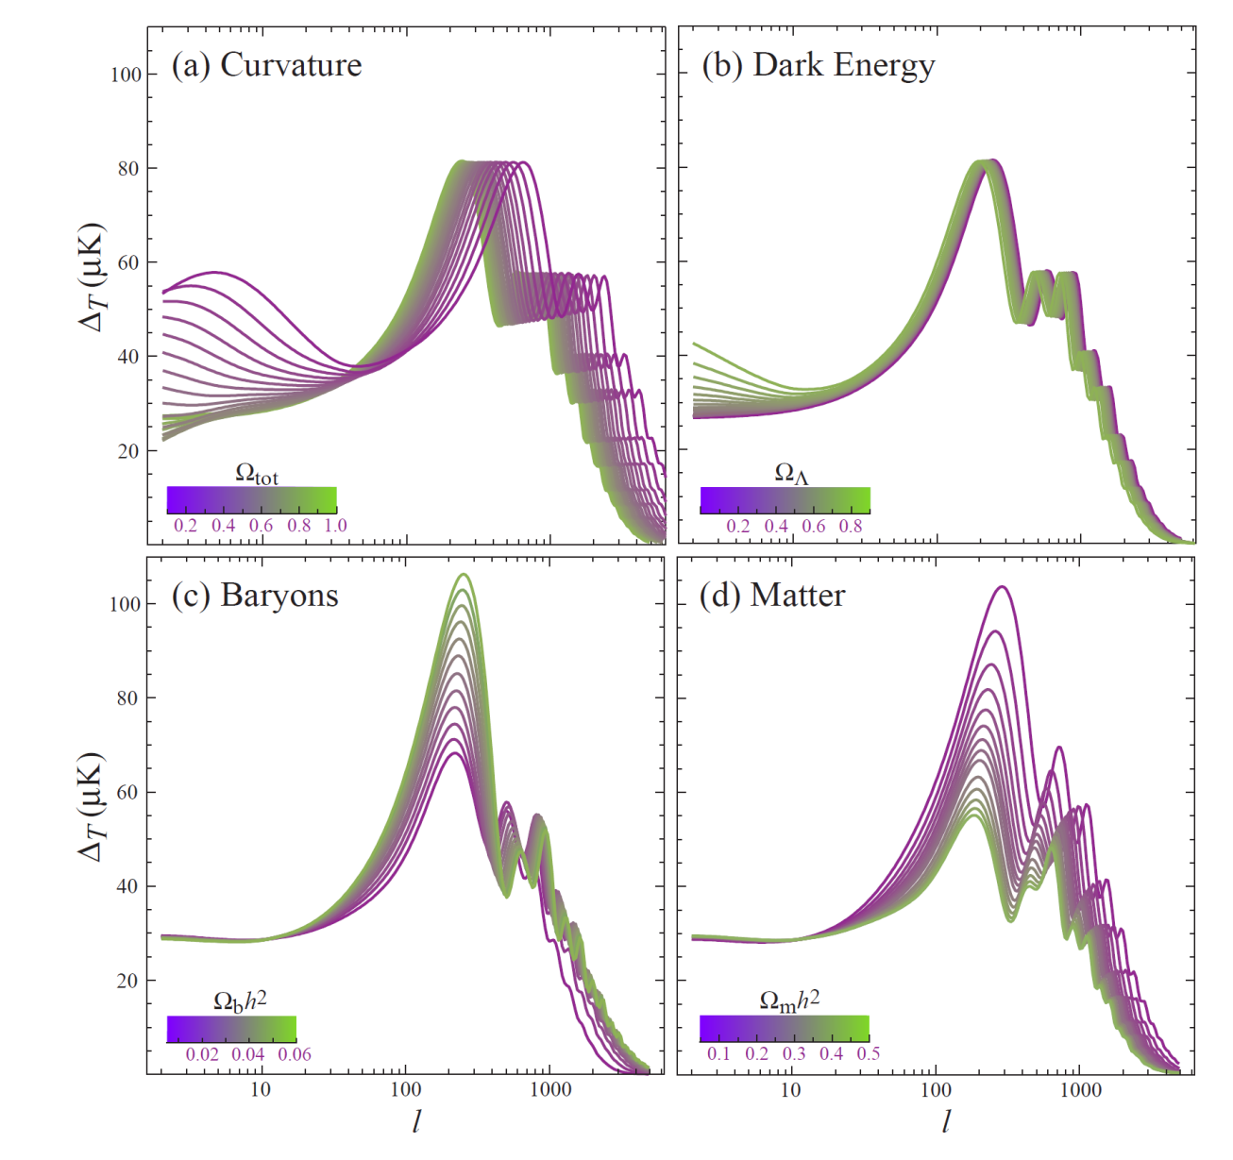
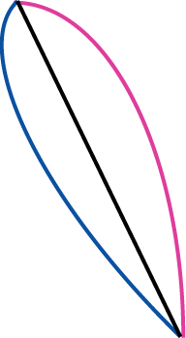
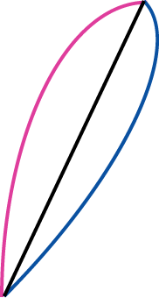
► CMB physics
5
K<0
K=0
K>0

Slide 7
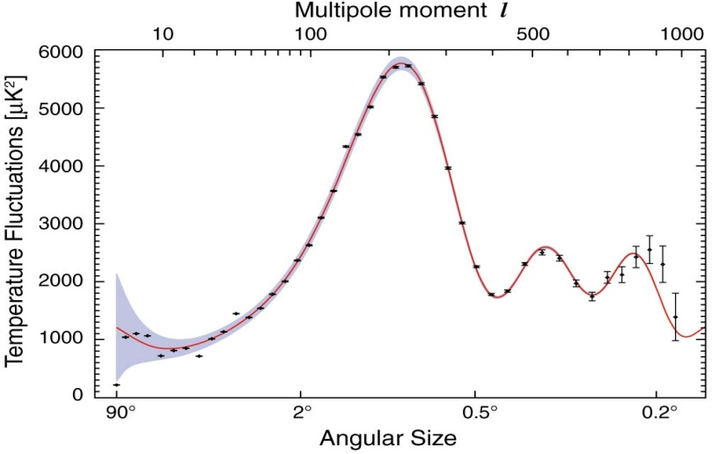

► Sachs-Wolfe (SW) effect
Flat plateau
SW effect : Dominant effect
◆ Last Scattering surface z~1091
Inhomogeneity
gravitational potential
→ red shift → temperature

Slide 8
► Evolution of fluctuation
Physical scale k : comoving wave number
Horizon scale
Horizon reenter
Horizon cross
inflation

Slide 9
► Adiabatic fluctuation
ζ ~constant
inflation
LS
For at LSS

Slide 10
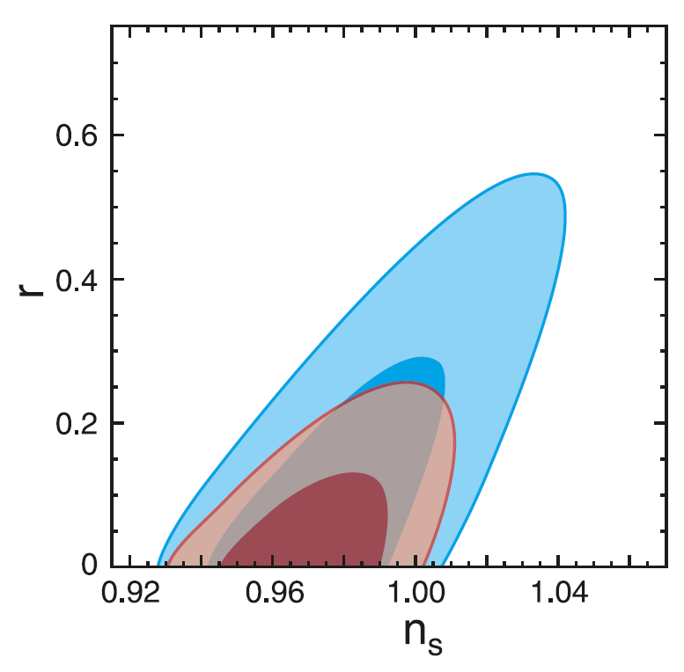
► WMAP 5yr date
Almost scale invariant, Almost Gaussian …
95％ C.L.
Pivot point
* No running
Consistent to the prediction from
“Standard” inflation ( Single-field , Slow-roll)

Slide 11
► Beyond linear analysis
Within linear analysis
Observational date → Not exclude other models
More information from Non-linear effects
･ Non-Gaussianity
WMAP 5yr 95％ C.L.
→ PLANCK (2009.5)
･ Loop corrections

Slide 12
► IR / UV divergences
◆ During inflation
Quantum fluctuation of inflaton
Quantum fluctuation of gravitational field
Ultraviolet (UV) & Inflared (IR) divergence
Regularization is necessary
Classicalization
Classical stochastic fluctuation
Observation → Clarify inflation model ??

Slide 13
► Outline
1. Introduction
2. Cosmological perturbation during inflation
3. IR divergence problem - Single field -
4. IR divergence problem - Multi field -
5. UV divergence problem
6. Summary and Discussions

Slide 14
Liner analysis

Slide 15
► Comoving curvature perturbation
◆ Gauge invariant quantity
Spatial curvature
Fluctuation of scalar field
“Gauge invariant variable”

Slide 16
► Gauge invariant perturbation
Gauge invariant perturbation
Completely Gauge fixing
Equivalent
“Completely gauge fixing”
Flat gauge
Gauge invariant
Comoving gauge

Slide 17
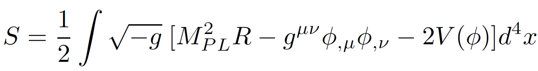
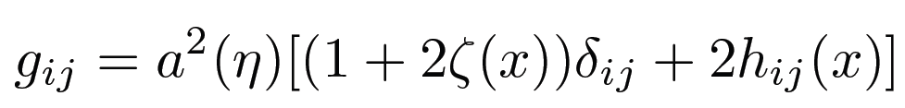
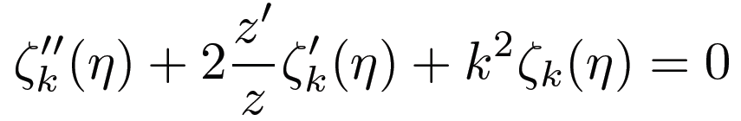

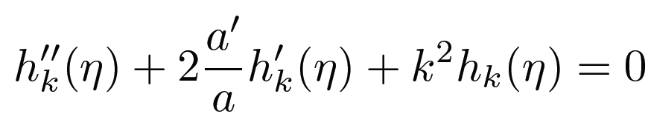
► Liner perturbation
◆ Single field inflation model
Comoving gauge
GW
Non-decaying mode as k/aH → 0

Slide 18
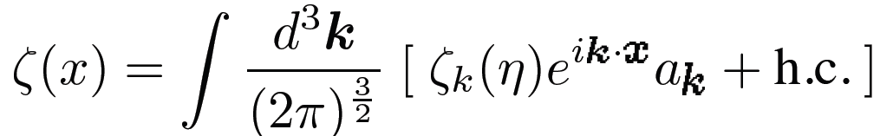
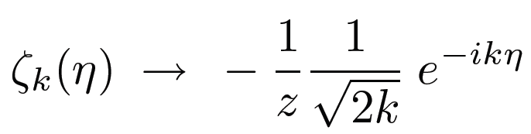
► Adiabatic vacuum
Positive frequency mode f.n. → Vacuum ( Fock space )
◆ Initial condition
In the distant past |η| → ∞,
⇔ k>>1 Much smaller than curvature scale
Adiabatic solution
~ Free field at flat space-time

Slide 19
► Scalar perturbation
ζ ~constant
hoc
Almost scale invariant

Slide 20
► Chaotic inflation
Inflation goes on
Reheating
Larger scale mode → Exit horizon earlier
→ Larger amplitude
Red tilt n_{s}< 1

Slide 21
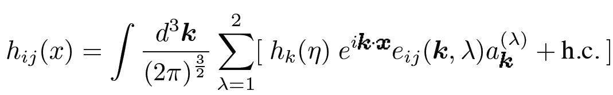
► Tensor perturbation
◆ Initial condition
In the distant past |η| → ∞,
Adiabatic solution
◆ Power spectrum
Almost scale invariant , Red tilt

Slide 22
Quantum correlation

Slide 23
► Linear theory
(i) Two point fn.
(ii) Three point fn.
0
Transition from y to x
x
x
y
y
z

Slide 24
► Non-linear theory
λ
← Expansion by free field
x
(i) Two point fn.
x
x
x
y
x
O(λ⁰)
O(λ¹)
O(λ²)
y
y
y
etc
y

Slide 25
► Non-linear theory
λ
(ii) Three point fn.
x
x
x
λ
y
z
y
z
y
z
etc
O(λ¹)
O(λ³)

Slide 26
► Summary of Interaction picture
Propagator ↑
↑ Vertex
1. Write down all possible connected graphs
Feynman rule
2. Compute the amplitude of each graph
Loop integral
q
Fourier trans.
x
z
y
k
k

Slide 27
Non-linear perturbation

Slide 28
► Interests on Non-linear corrections
Primordial perturbation ζ
x
y
x
y
x
x
More information on inflation
y
z
y
z
x
w
y
z
and so on…

Slide 29


► ADM formalism
Comoving gauge
S = S_{EH} + S_{φ} = S [ N, N_{i}, ζ ]
e^{ρ}: scale factor
◆ Lagrange multiplier N / N_{i}
Maldacena (2002)
Hamiltonian constraint ∂ L / ∂ N = 0
N = N[ζ]
→
Momentum constraint ∂ L / ∂ N_{i} = 0
N_{i} = N_{i} [ζ]
S [ N, N_{i}, ζ ] = S [ ζ ]

Slide 30

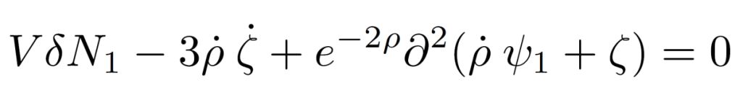
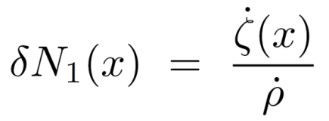
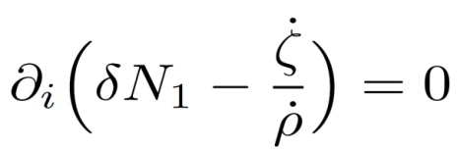
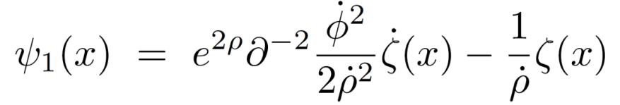
► Non-linear action
1st order constraints
2nd order constraints
(ex) 1st order constraints

Slide 31
► NGs / Loop corrections
“Quantum origin” ( Mainly until Horizon crossing)
2002 J.Maldacena
Single field with canonical kinetic term
NG → Suppressed by slow-roll parameters
2005 Seery &Lidsey
Single & Multi field(s) with non-canonical kinetic term
NG → Dependence on the evolution of sound speed
2005, 2006 S.Weinberg
Loop correction amplified at most logarithmic order
2004 D.Boyanovsky
2007 M.Sloth
IR divergence in Loop corrections → Logarithmic
2007 D.Seery
2008 Y.U. & K.Maeda
and so on

Slide 32
► IR divergence problem
◆ One Loop correction to power spectrum
Mass-less field ζ
Scale-invariant
< ζk ζk’ >
Next to leading order
q
k
k'
Momentum ( Loop )integral
∫d³q |ζ_{q}|² = ∫ d³q /q³
Log. divergence

Slide 33
► Outline
1. Introduction
2. Cosmological perturbation during inflation
3. IR divergence problem - Single field -
4. IR divergence problem - Multi field -
5. UV divergence problem
6. Summary and Discussions

Slide 34
► Our purpose
Primordial perturbation
Loop integral
diverge
To extract information from loop corrections,
we need to discuss …
“ Physically reasonable regularization scheme ”
( Note )
Increasing IR corrections
Spectrum : Large Dependence on IR cut off

Slide 35
► IR divergence problem
◆ Loop corrections
Fluctuations computed by Conventional perturbation
Vertex integral
Diverge
Fluctuations we actually observe ex. CMB
Finite
Strategy
・ Propose “How to compute observables”
・ Prove “Regularity of observables”

Slide 36
Violation of Causality

Slide 37
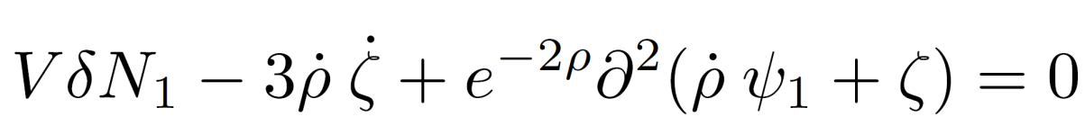
► Non local system
◆ Constraint eqs.
Hamiltonian constraint ∂ L / ∂ N = 0
N = N[ζ]
→
Momentum constraint ∂ L / ∂ N_{i} = 0
N_{i} = N_{i} [ζ]
: Solutions of Elliptic type eqs.
(ex) 1st order Hamiltonian constraint
Non local term

Slide 38
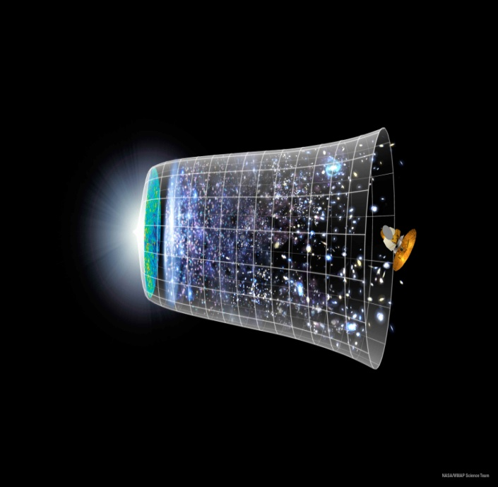
► Causality
We can observe fluctuations within “Causal past J⁻(p) ”
A portion of Whole universe
η
.
p
Observation
ζ(x)
x
Initial

Slide 39
► Violation of Causality
ζ(x) x ∈ J⁻(p) affected by { J⁻(p) }^{c}
t
.
p
◆ Definition of fluctuation
δQ (x) = Q(x) ‐ Q
ζ(x)
Observation
x
Q : Average value
Initial
Conventional perturbation theory
Q : Average value in whole universe
Notes:
Complementary set 補集合

Slide 40
- Chaotic inflation -
Amplitude of ζ
δ² ζ ∝ H² / ɛ
Large scale fluctuation → Large amplitude
Q
Q on observable region
ⅹ
Q on whole universe
Large fluctuation we cannot observe
( Q - Q )² < < ( Q - Q )²

Slide 41
► Violation of Causality 2
ζ(x) x ∈ J⁻(p) affected by { J⁻(p) }^{c}
◆ Gauge fixing
Completely gauge fixing
at whole universe
☠ Impossible
Gauge invariant
- We can fix our gauge only within J⁻(p).
- Change the gauge at { J⁻(p) }^{c}
→ Influence on ζ(x) x ∈ J⁻(p)
Notes:
Complementary set 補集合

Slide 42
Gauge degree of freedom

Slide 43
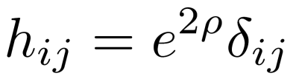
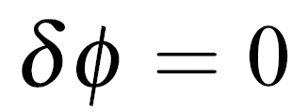
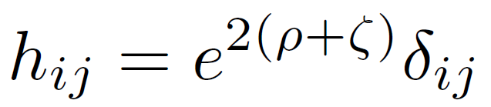
► Gauge choice
NGs / Loop corrections Computed in
Flat gauge
Comoving gauge
Maldacena (2002), Seery & Lidsey (2004) etc..
- Gauge degree of freedom
: Solutions of Elliptic type eqs.
DOF in Boundary condition

Slide 44



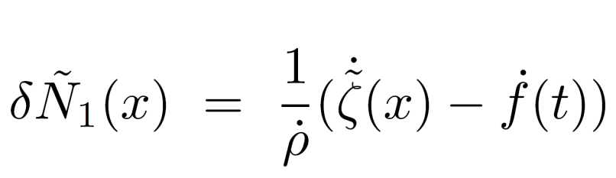
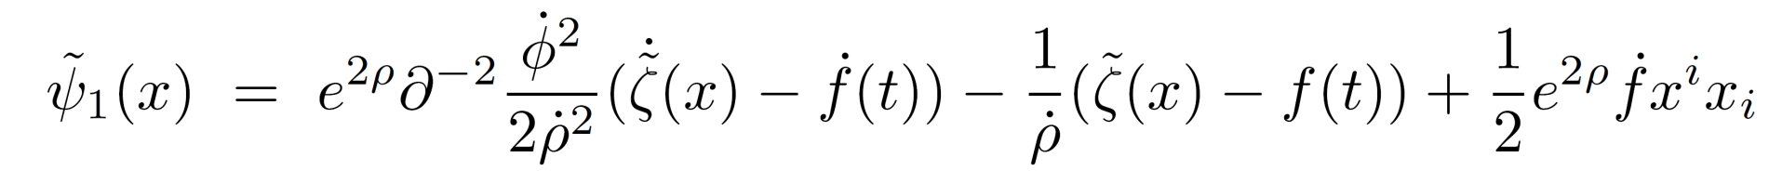
► Boundary condition
Solution 1
Arbitrary integral region
Solution 2

Slide 45

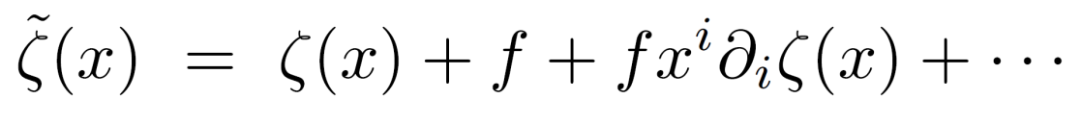
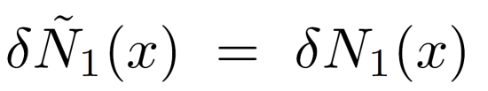
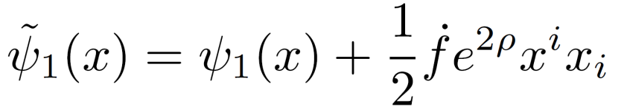
► Scale transformation
keeping Gauge condition
～
Scale transformation x^{i} → x^{i} = e ^{- f(t)} x^{i}

Slide 46

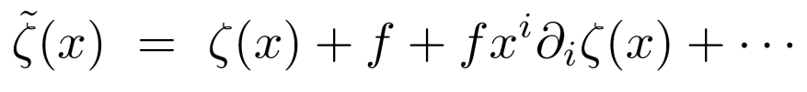





► Scale transformation
Solution 1
Solution 2

Slide 47
► Gauge condition
Change homogeneous mode
Additional gauge condition
“Causal evolution” : Not affected by { J⁻(p) }^{c}
(1) Observable fluctuation
＝０
Averaged value at J⁻(p)
(2) Solution of Poisson eq. ∂⁻²

Slide 48
► Gauge invariant perturbation
◆ Naïve understanding
∂ L / ∂ N = 0
Local gauge condition
No Influence from { J⁻(p) }^{c}
Fix Gauge within J⁻(p) → Determineζ(x) x ∈ J⁻(p)
Recovery of Gauge invariance

Slide 49
► Quantization
◆ Initial condition
: Curvature at ordinal comoving gauge
Adiabatic vacuum
P (k) ∝ 1 / k³
Divergent IR mode
Gauge transformation
: Curvature at local comoving gauge
We prove IR corrections of are regular.

Slide 50
► Regularization scheme
Effective cut off by k~ 1/L_{t}
“Cancel” IR divergence
L_{t}: Scale of causally connected region
Exceptional case
Extremely long inflation
Higher order corrections might dominate lower ones.
Validity of Perturbation ??

Slide 51
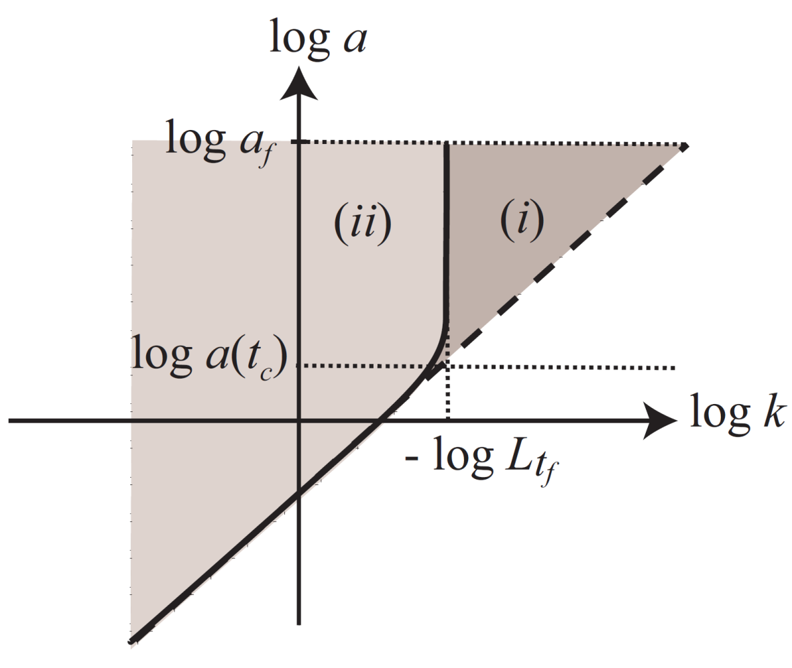

► Regularization scheme
Dotted line : horizon scale
Thick line : “Suppression scale”
(i) Well suppressed
→ UV cut off
(ii) For l-th loop corrections
s.t.
Dominated by contributions from the early time

Slide 52
► Outline
1. Introduction
2. Cosmological perturbation during inflation
3. IR divergence problem - Single field -
4. IR divergence problem - Multi field -
5. UV divergence problem
6. Summary and Discussions

Slide 53
► Multi-field generalization
◆ Local flat gauge
δs
δσ
～
δσ (x) = δσ (x) ‐ δσ
Local average = 0
♯ : Number of IR divergent fields
Background trajectory
（1） ♯ = 1
IR regular
✔
（2） ♯ ≧ 2
Gauge invariant → Still diverges

Slide 54
► IR divergence in Multi-field model
◆ Squeezed wave packet
IR mode < δsk δsk > ∝ 1 / k³ Highly squeezed
phase space
π_{k}
δs_{k}
～
～
＜O(x) O(y) O(z)…＞ O = δσ, δ s
☠ Origin of IR divergence

Slide 55
► IR divergence in Multi-field model
◆ Squeezed wave packet
IR mode < δsk δsk > ∝ 1 / k³ Highly squeezed
phase space
π_{k}
A portion of wave packet
δs_{k}
Observable fluctuation
～
～
＜O(x) O(y) O(z)…＞ O = δσ, δ s
Prove IR regularity of observables

Slide 56
► Wave packet of universe
Early stage of Inflation
Observation time t = t_{f}
Superposition of
| δs >
Statistical Ensemble
Correlated
Uncorrelated
Cosmic expansion
Various interactions
Decoherence
One of Wave packet
→ Realized
Wave packet of | δs >

Slide 57
► Parallel world
t = t_{f}
Pick up
Our universe
Causally disconnected universe
t = t_{i}
In , another wave packet may be picked up.
However, we cannot know what happens there.

Slide 58
► Projection
σ
Proof of IR regularity
α
Our “Observables”
＜P(α) O(x) O(y) …＞
If finite
≩
⊋
Actual observable correlation fn.
← Finite

Slide 59
► Regularization scheme
～
～
＜ P(α) O(x) O(y) O(z)….＞ O = δσ, δ s
phase space
π
δs
After decoherence, a portion of wave packet contributes
◆ Loop integrals
Momentum integrals Regular
Temporal integral Logarithmic secular evolution

Slide 60
► Outline
1. Introduction
2. Cosmological perturbation during inflation
3. IR divergence problem - Single field -
4. IR divergence problem - Multi field -
5. UV divergence problem
6. Summary and Discussions

Slide 61
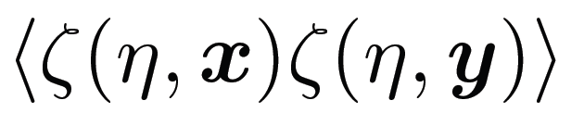
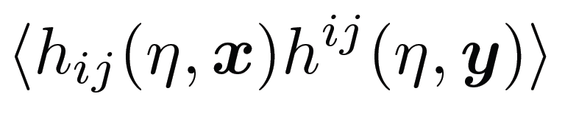
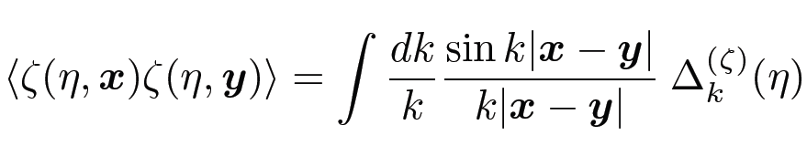
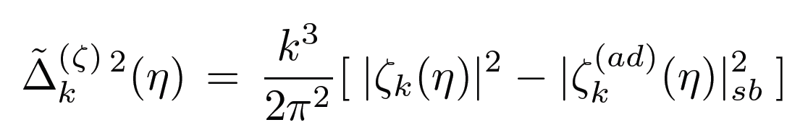
► UV regularization
ζ : curvature perturbation / h_{ij} : GW
Diverge in x → y limit
◆ Adiabatic regularization
Parker & Fulling (1974)
UV mode ~ Solution in adiabatic approximation
Adiabatic expansion
☠ Divergent
Regular

Slide 62
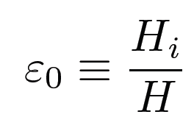
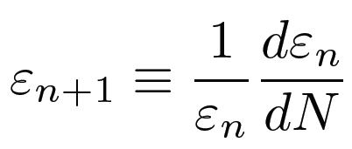
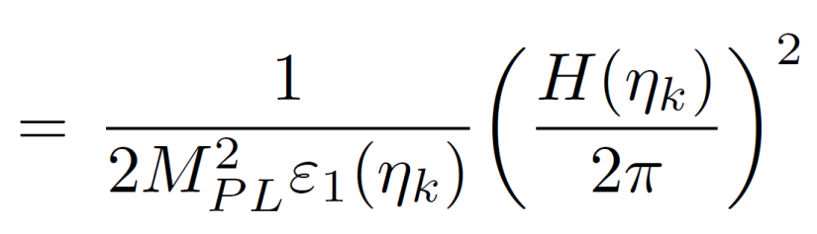
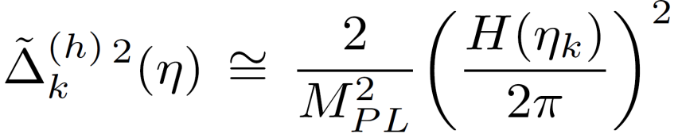
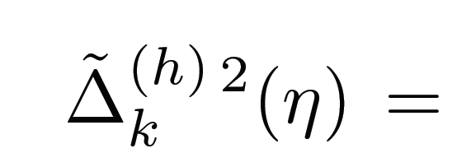
► Influence from Adiabatic reg.
Parker (2007), Parker et.al. (2008/2009)
Single field inflation
×( Slow-roll parameter )
×( Slow-roll parameter )
Amplitudes of ζ / GW suppressed by subtraction terms
at horizon crossing time

Slide 63
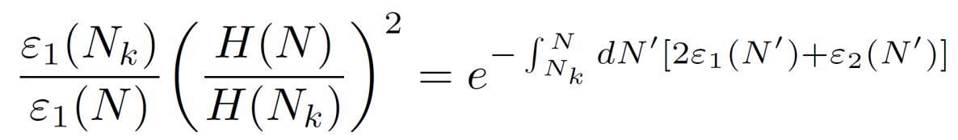
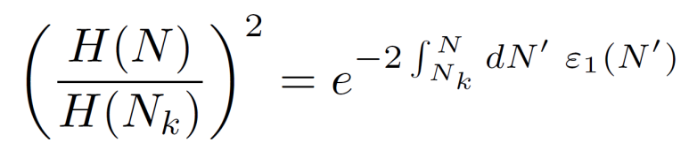
► No Influence from Adiabatic reg.
A.Starobinsky & YU (2009)
Exact solution
Solution in Adiabatic approx.
Super horizon limit
Constant value
Decay
Negligible

Slide 64
► Summary - IR regularization -
◆ Single field case
Flat gauge
Comoving gauge
+ Local gauge G ：“Causality” is preserved
NGs/Loop corrections are free from IR divergence
( except for models with extremely long durations )
◆ Multi field case
Gauge fixing is not enough to discuss observables
To consider them, we need to consider “decoherence”.
We cannot deny the existence of secular evolution.

Slide 65
► Summary - UV regularization -
◆ Adiabatic regularization
Regularize UV divergence
, which appears in the coincidence limit
We should introduce subtraction terms for all modes
However…
Subtraction term decays during cosmic evolution
→ No-influence on observables

Slide 66
- Supplement -

Slide 67

► Decoherence process
τ = τ_{i}
Correlated
Superposition of | >
Initial state : adiabatic vacuum | 0 >ad
| 0 >ad = ∫d | >< |0 >ad
Include the contribution from all wave packets
ad < 0 | ζ(x1) ζ(x2) ζ(x3) … |0 >ad
Overestimation
3. Regularization scheme ~ Multi field ~

Slide 68
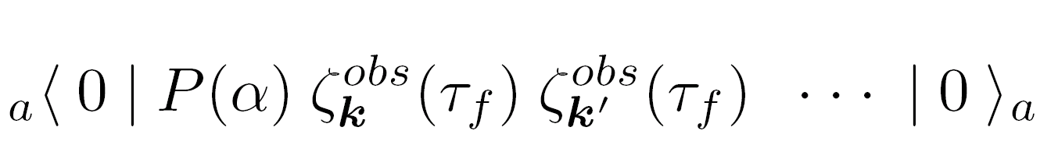
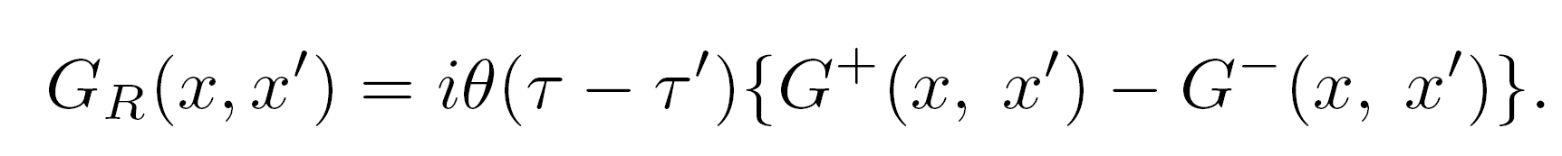
► Expansion by Retarded Green fn.
◆ Closed Time Path
Evolution of < in | ** | in >
time
G_{F}
G_{D}
G⁺ or G－
CTP
Expansion by G_{F} , G_{D} , G⁺, G－
◆ Expansion by Retarded Green f.n.
x
@ Causally connected region
≠0, Finite value
G_{R} : Regular in IR limit
・x’
Expansion by G_{R}

Slide 69
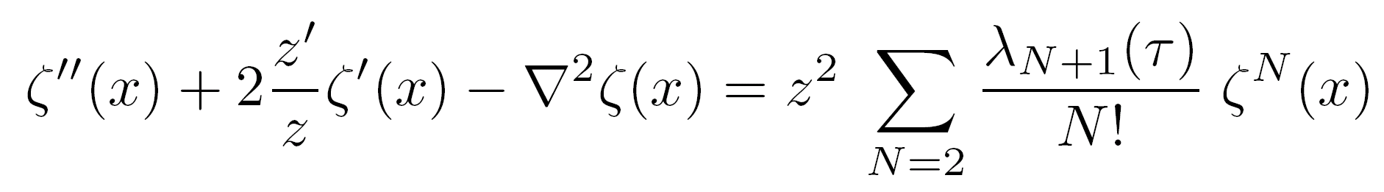
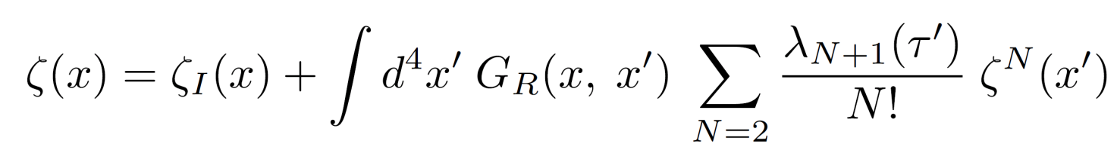
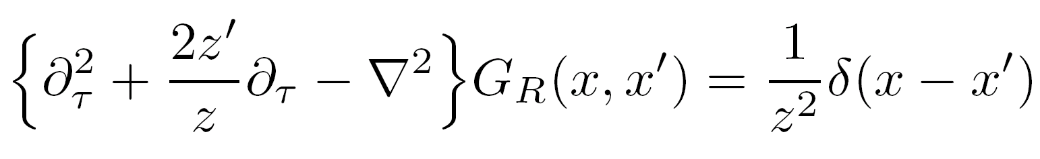
► Expansion by Retarded Green fn.
[ Detailed exp. ]
R
(Ex.) N = 4
=
+
R
=
+
R
+
R
R
・・・
R
+
R
R
+ ・・・
=
+

Slide 70
► Expansion by Retarded Green fn.2
◆ Contraction
R
Contraction
k
k'
R

Slide 71
► Mode expansion
3. Proof of IR regularity
[ Detailed exp. ]
= ∑ ( IR regular functions G_{R}^{m}) × a< 0 |P(α)ζI ζI … ζI | 0 >a
IR regular ??
~ Eigenetate for ζ_{I} with finite wave packet
・Without P (α)
→ ∞
Infinite region
Finite
・With P (α)
Finite region
Finite

Slide 72
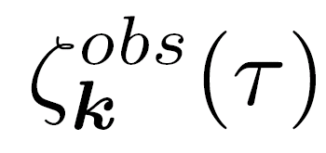
► Recent topics
Lyth (2007)
Necessity to consider Local quantity ( |x| < L )
→ Introduction of IR Cut off 1/L
Local quantity Cut off only for external momentum
Bartolo et. al (2008)
Stochastic inflation → Decoherence
Riotto & Sloth (2008)
k < kc Stochastic fluctuation
Enqvist et.al. (2008)
Neglecting a part of quantum fluctation
Include the artificial cut-off scale
Under-estimation of IR corrections
→ Doubtful

