Slide 1
Higgs branch localization of 3d theories
Masazumi Honda
Harish-Chandra Research Institute
Ref.: arXiv:1312.3627 [hep-th]
Based on collaboration with
Masashi Fujitsuka (SOKENDAI) & Yutaka Yoshida (KEK→KIAS)
6th, Mar, 2014
Progress in the synthesis of integrabilities
arising from gauge-string duality @KKR Hotel Biwako
Notes:
20+5?

Slide 2
Cf.
[Pestun ’08]
(I expect) Imamura-san talked about…
For partition functions of SUSY gauge theory on S_{b}³, S²xS¹ and S_{b}³/Z_{n} ,
Localization
w/ certain deformation
[Hama-Hosomichi-Lee ’11,
Imamura-Yokoyama, etc…]
Explicit
evaluation
[Pasquetti, Taki, etc…]
Where do the vortices come from?

Slide 3
Our strategy
Cf.
[Pestun ’08]
For partition functions of SUSY gauge theory on S_{b}³, S²xS¹ and S_{b}³/Z_{n} ,
“Coulomb branch localization”
“Higgs branch localization”
Localization
w/ certain deformation
Localization
w/ different deformation
[Hama-Hosomichi-Lee ’11,
Imamura-Yokoyama, etc…]
Explicit
evaluation
[Pasquetti, Taki, etc…]
Where do the vortices come from?

Slide 4
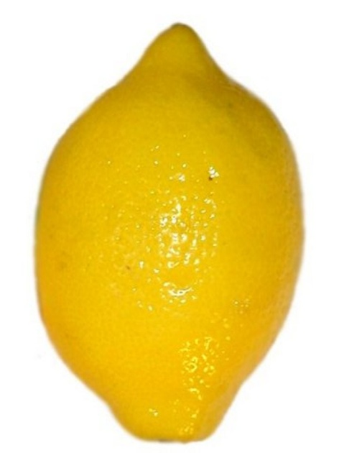
Quick Conclusion
[A work with few overlaps: Chen-Chen-Ho ]
[A work with substantial overlaps: Benini-Peelers
(appeared 10 days later from our paper) ]
on squashed S³ and S¹xS²
x
S¹
S²
squashed S³
New deformation term
Saddle points = Vortices!

Slide 5
Advantage of Higgs branch localization
“Coulomb branch localization”
“Higgs branch localization”
Explicit
evaluation
If we know the vortex partitions functions,
then we can get exact result.
Namely, the matrix model is automatically solved!
We need to exactly solve the matrix model.

Slide 6
Contents
(I omit S²xS¹ case.)
1. Introduction & Motivation
2. Coulomb branch localization on S_{b}³
3. Higgs branch localization on S_{b}³
4. Summary & Outlook

Slide 7
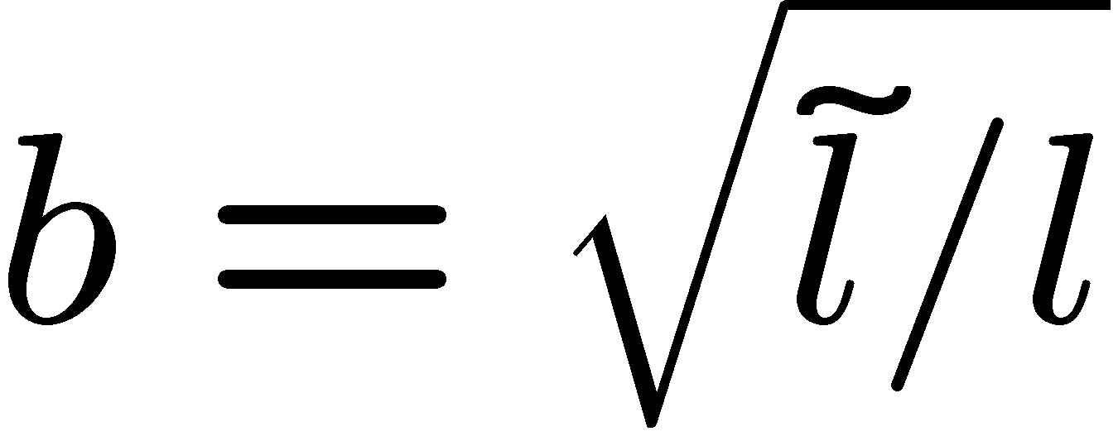
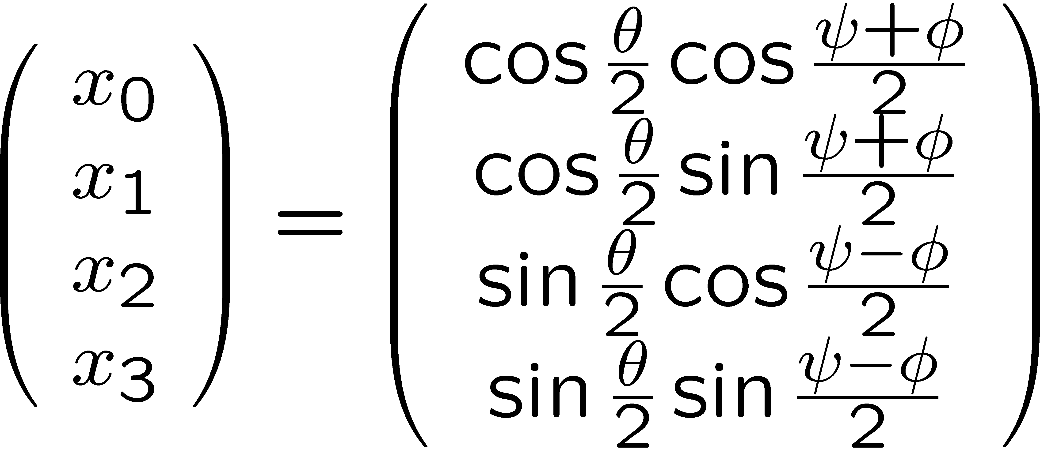
Squashed S³ = S_{b}³
[Hama-Hosomichi-Lee ‘11]
・ We consider 3d ellipsoid:
[Cf. Universality among several squashed spheres:
Closset-Dumitrescu-Festuccia-Komargodski ’13 ]
Hypersurface:
in
= 1-parameter deformation of usual S³ by parameter
・ We can take “Hopf-fibration” coordinate:

Slide 8
Coulomb branch localization
[Hama-Hosomichi-Lee ,
Imamura-Yokoyama,
Drukker-Okuda-Passerini, etc ]
If we choose the deformation term as
Saddle point:
(up to gauge trans.)
Coulomb branch!
Result:

Slide 9
Some examples
Ex.1) U(N) SYM with CS- and FI-terms:
Ex.2) SQED with Nf-fundamentals, FI-term and masses:
Ex.3) U(N) SQCD with Nf-fundamentals and anti-fundamentals, FI-term and masses:
Ex.4) U(N) x U(N) ABJM:

Slide 10
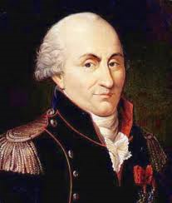
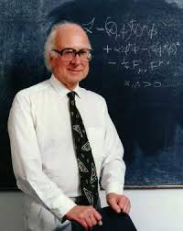
From Coulomb
To Higgs

Slide 11
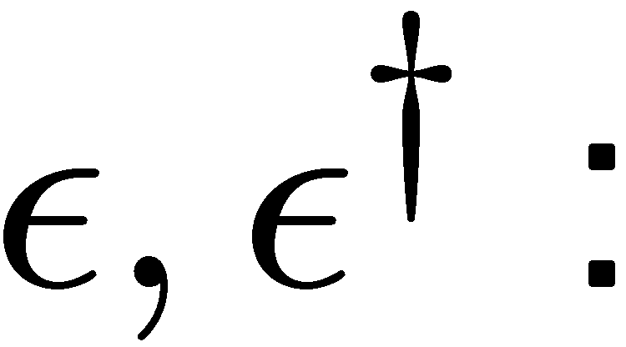
From Coulomb to Higgs
[Actually this is import from 2d
cf. Benini-Cremonesi ’12,
Doroud-Gomis-Floch-Lee ’12 ]
We use a different deformation term:
New!!
where
h : a function of scalars depending on setup
SUSY trans. parameter (bosonic spinor)
Ex. 1)
For
SYM + fundamental matters
(χ：Constant)
Ex. 2)
Adding anti-fundamental
Ex. 3)
Adding adjoint

Slide 12
Saddle point
For simplicity,
let’s consider SQCD with mass matrix M & Δ=0.
Since χ appears only in deformation term,
(final result)
=
(χ-independent )
If we take the limit χ→∞, nonzero contribution comes from
1. Away from the poles
Higgs branch!
2. At north pole (θ=0)
Vortex equation!
3. At south pole (θ=π)
Anti-vortex equation!

Slide 13
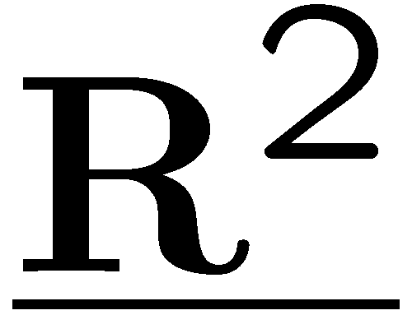
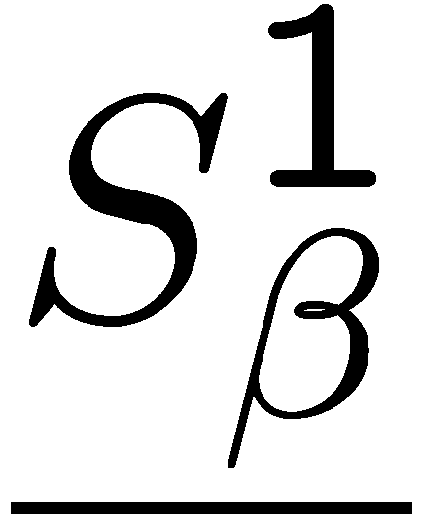
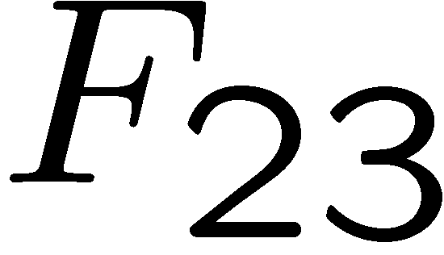
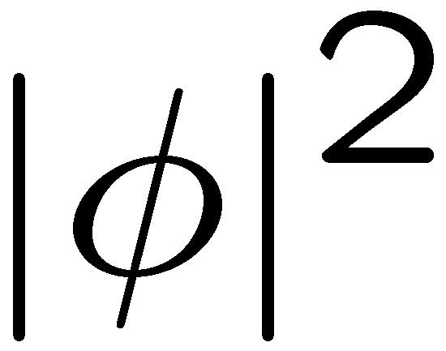
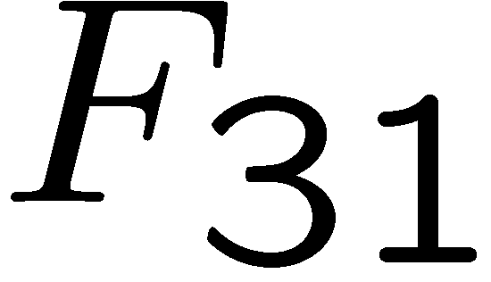
x
Zoom up around θ=0
Zoom up around θ=π
x
Point-like vortex!

Slide 14
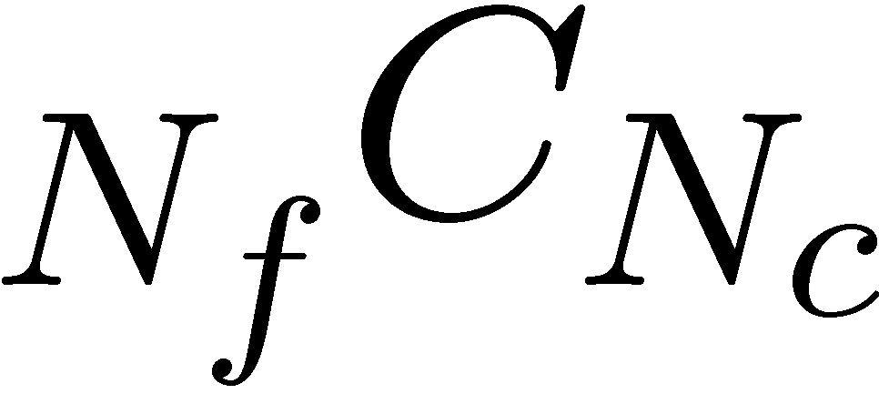
Saddle point away from the north and south poles
Saddle point:
With explicit indices,
If φ is eigenvector of M, φ must be also eigenvector of σ.
Then, up to flavor and gauge rotation,
Path integral becomes just summation
over discrete combinations!

Slide 15
Total expression
Thus, we obtain
where
Similar arguments are also applicable
when we add anti-fundamental
and adjoint matters
with general R-charges
(anti-)vortex partition function
If we know (anti-)vortex partition function, we can get exact result!
Compute vortex partition function!!

Slide 16
Vortex partition function
By applying localization method to the vortex quantum mechanics,
we can compute vortex partition function.
where
ζ: FI-parameter, ε: Ω-background parameter, β: S¹-radius

Slide 17
Identification of parameters
We must translate vortex language into the original setup.
・S¹-radius β = Hopf-fiber radius
・Ω background parameter ε = Angular rotation parameter
From SUSY algebra,
・Equivariant mass m^{V}
If we naively take
this does not agree with the Coulomb branch results…

Slide 18
Mass identification problem
If we naively take
this does not agree with the Coulomb branch results…
However, if we take
this agrees with the Coulomb branch result for all known cases.
(We haven’t found this justification from first principle yet.)
This would be similar to Okuda-Pestun Problem for instanton partition function
in 4d N=2* theory
[ Okuda-Pestun]

Slide 19
Summary & Outlook

Slide 20
Summary
Cf.
・ We have directly derived
・ The vortices come from
x
S¹
S²
・ BPS Wilson loop also enjoys factorization property

Slide 21
Possible applications
・ Study different observables
Vortex loop
[Coulomb branch localization:
Drukker-Okuda-Passerini ’12, Kapustin-Willett-Yaakov ’12]
・ Work on different spaces
S_{b}³/Z_{n}
[Coulomb branch localization: Imamura-Yokoyama ’12, factorization: Imamura-Matsuno-Yokoyama]
A subspace of round S³ with Dirichlet boundary condition
[Coulomb branch localization: Sugishita-Terashima ’12]
・ Work in higher dimensions (including S² in a sense)
4d superconformal index
[Coulomb formula: Kinney-Maldacena-Minwalla-Raju ’05, etc, factorization: Yoshida]
S²xT²
[Some rich structures? : Cecotti-Gaiotto-Vafa ’13]

Slide 22
Some interesting directions
・Vortex partition functions are known for very limited cases
We don’t know even “what is moduli?” for many cases
It is very interesting if we get vortex partition function for M2-brane theories
・Vortex partition function is related to topological string
Can we more understand relation between ABJ and topological string ?
(on local P¹ x P¹)
・Partition function on S_{b}³ ~ Renyi entropy of vacuum in 3d CFT
[Nishioka-Yaakov ’13]
What does the vortex structure imply?

Slide 23
Thank you

