Slide 1
Some Topics on the Modular Completions in SL(2)/U(1) Supercoset Theory
2014/3/7, JSPS/RFBR Workshop,
Ritsumeikan Univ.
Ritsumeikan Univ. Yuji Sugawara

Slide 2
Main references:
Eguchi-Y.S , JHEP 1103(2011)107, (arXiv:1012.5721[hep-th])
Y.S, JHEP 1201(2012)098,
(arXiv:1109.3365[hep-th])
Y.S, arXiv:1311.4708[hep-th]
+ Work in progress

Slide 3
Introduction
SL(2)/U(1) supercoset (N=2 Liouville theory)
Simplest non-rational N=2 SCFT
Describes a curved, non-compact background (‘cigar geometry’)
Elliptic genus (supersymmetric index) is modular, but non-holomorphic.
[Troost 2010, Eguchi-Y.S 2010]
What extent controllable ？

Slide 4
Main Aim of This Talk
Show that :
Path-integration
Elliptic Genus of SL(2)/U(1)
‘non-holomorphic Eisenstein series’

Slide 5
Contents
1. Introduction
2. Path-Integral in SU(2)/U(1) (N=2 minimal)
3. Path-Integral in SL(2)/U(1) and
the ‘Modular Completion’
4. Summary and Discussions

Slide 6
2. Path-Integral in SU(2)/U(1) Supercoset
(N=2 Minimal Model)

Slide 7
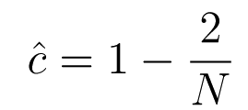
SU(2)/U(1) Supercoset
N=2 minimal model
supercoset
(
)
A simple 2-dim. rational superconformal field thoery
Basic properties are well-known.

Slide 8
Elliptic Genus of SU(2)/U(1)
Elliptic genus :
[Witten 93, Henningson 93]
Directly calculable by path-integration of
the SU(2)/U(1)-supergauged WZW model
periodic b.c. for world-sheet fermions,
angle variable ‘z’ = modulus of U(1) gauge field
Evaluated by ‘localization techniques’ [Henningson 93]

Slide 9
Elliptic Genus of SU(2)/U(1)
Jacobi form of weight 0
(good modular and spectral
flow properties)

Slide 10
Fourier Expansion of Elliptic Genus
Moreover, the N=2 minimal model characters are directly
obtained from the elliptic genus by Fourier expansion :
Spectral flow
N=2 Mimimal model character

Slide 11
Path-Integral in SL(2)/U(1) Supercoset
and the “Modular Completion”

Slide 12
SL(2)/U(1) case ?
Consider the path-integral evaluation of
elliptic genus . (Expect good modular &
spectral flow properties )
The evaluated elliptic genus is modular, but non-holomorphic
(~ ‘non-holomorphic Eisenstein series’)

Slide 13
Fourier expanded in terms of
the ‘modular completions’ of
(extended) characters
(NOT characters themselves…)

Slide 14
‘Modular Completions’ in SL(2)/U(1)
‘Modular completion’
(
)
‘extended discrete character’
= sum over spectral flows of irreducible
characters

Slide 15
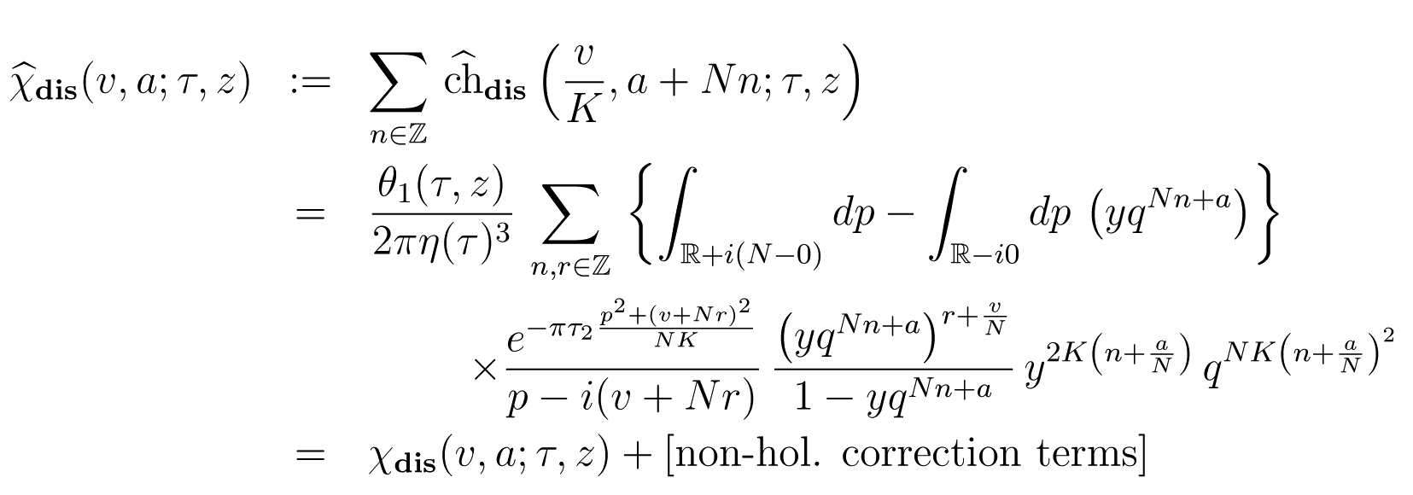
‘Modular Completions’ in SL(2)/U(1)
explicitly written as :

Slide 16
‘Modular Completions’ in SL(2)/U(1)
“mixing term”
(no mixing term)

Slide 17
Path-Integral Evaluation of Torus Partition Function [Eguchi-Y.S. 2010]
Torus partition function ( sector)
: N=2 U(1)-currents
The discrete part of partition function is naturally
expanded by the modular completions.

Slide 18
Elliptic Genus
？
Partition Function
Elliptic Genus
Set , with keeping generic
Right moving bosonic & fermionic
excitations are cancelled out.
But, still non-holomorphic !
Non-trivial contributions from infinite winding modes

Slide 19
Path-Integral Evaluation of Elliptic Genus of SL(2)/U(1)
[Troost 2010, Eguchi-Y.S 2010]
winding modes
regularization factor
bosonic & fermionic determinant
How can we carry out the modulus integral ？

Slide 20
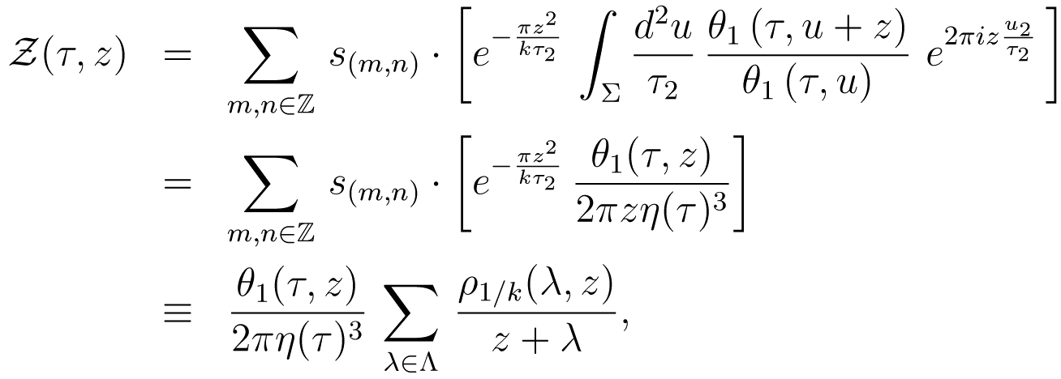
Spectral flow operator
kind of ‘unwound’
model
( , )
Non-holomorphic

Slide 21
‘Non-holomorphic Eisenstein Series’
Namely, we have obtained :
( ~ non-holomorphic analogue
of Eisenstein-series )

Slide 22
‘Non-holomorphic Eisenstein Series’
Simplest functional form
Modular and spectral flow properties are manifest. (non-holomorphic Jacobi form)
Modular completions are recovered by making
Fourier expansion (as in SU(2)/U(1)):
Simply evaluated this way

Slide 23
4. Summary and Discussions

Slide 24
Path-integral evaluation of the elliptic genus
of SL(2)/U(1) supercoset
Expressible in terms of the ‘non-holomorphic Eisenstein series’
manifest modular & spectral flow properties
The modular completions of the extended
characters are naturally reproduced by Fourier
expansion (like the N=2 minimal model)
(cf ‘mock modular form’ & ‘harmonic Maass form’)
[Zwegers 2002]

Slide 25
A curious identity for the case of
[Y.S 2013, Giveon-Itzhaki-Troost 2013] :
‘analytic continuation’ of N=2 minimal (N → - N) ？
‘compactification’ of SL(2)/U(1) ？
Non-holomophic terms
cancel out !

Slide 26
Thank you very much
for your attention!

